Slide 1

COMPUTING SCIENCE - GRADED UNIT 2
Questionnaire - Advice

Slide 2
Why do we need to gather facts?
To assist in clarifying the software brief
  The Analyst needs to verify their understanding of the system
To assist in the development of the requirements
  Developers need clear and usable requirements that can help guide the product through the development process
Helps uncover information about the business rules that might not be in the brief
  Business rules are the policies and constraints of the business – any successful software project must conform to these
To gather information on cost and deadlines

Slide 3
Fundamental Questions to be asked
You are required to ask 1 sensible question about each of the following topics:
  1 - User Interface question(s)
  2 - Roles: what users can do
  3 - Specific stored information (attributes)
  4 - Existing data
  5 - End date for system
  6 - Cost
  7 - Information about payments
  8 – Security (logging in etc.)
Then ask a further 10-12 specific questions on any of these topics to gain further info
Your questionnaire will be a total of 18 (min) – 20 (max) questions

Slide 4
Questionnaire Format
Types of questions:
  (Include at least one of each type)
  Closed-end (YES/NO)
  Limited-response (choose from a list)
  Open Ended (best for detailed answers)
Important - Group similar topic questions together
Important - Take the responder through a logical journey. E.g. don’t do:
    Q1 – What did you think of the movie's conclusion?
    Q2 – What did you think about the start of the movie?
    Q3 – What did you think about the middle?

Slide 5
Sample Questions
When is the deadline?
What is the budget?
What details do you need to hold about a customer?
What type of roles are required for staff members?
What info needs to be stored about a product / booking item?
How should orders / bookings be paid for?

Slide 6
Sample Questions
How does a user sign in / access the system?
Is 2 factor authentication required to login?
Can you buy / book without being registered?
Are there discounts?
How should products be displayed / categorised?
Should delivery options be considered?

Slide 7
Sample Questions
Can customers cancel orders / bookings?
Are there restrictions on cancellations?
Are staff members allowed to book / buy / cancel?
Are there any reports required for total orders / booking info? If so, which format?
Are emails required to confirm orders / bookings?
Should SMS be sent to confirm orders / bookings?

Slide 8
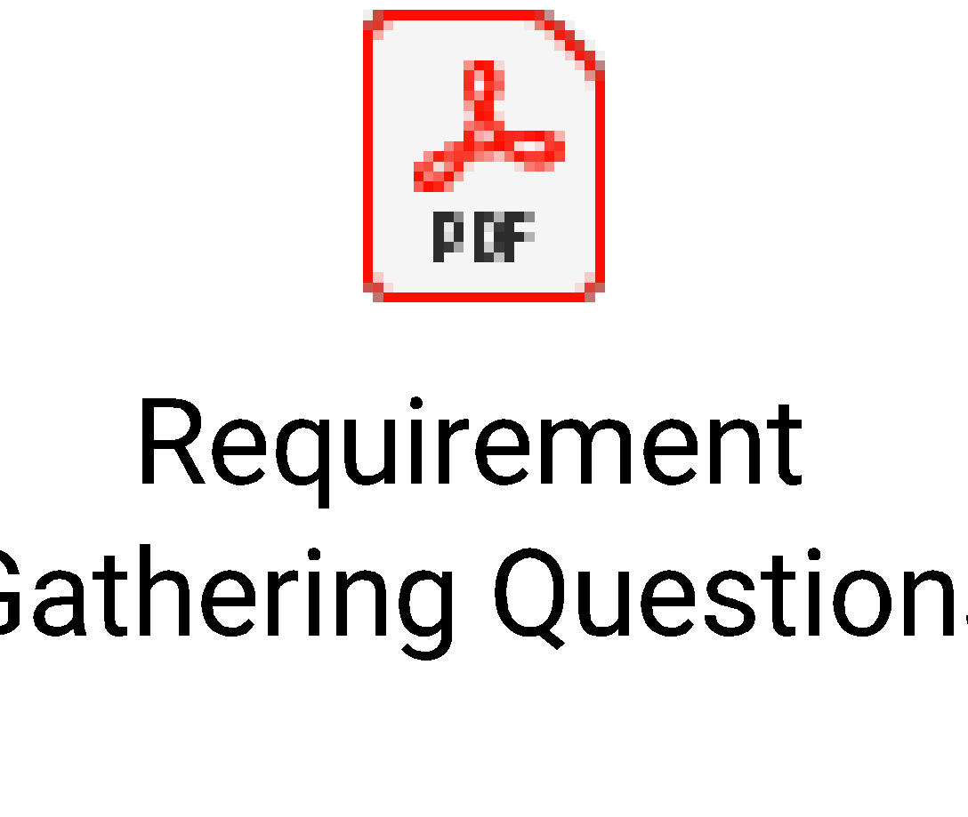

Examples
https://www.teamgantt.com/blog/7-questions-every-project-manager-should-ask-their-client
The below 3 files are also found in the “Example Questions” folder

Slide 9
Remember…
18 (min) – 20 (max) questions
No less, no more
You will lose marks if you go over this. It’s not a case of “create 10000 question to impress”.
20 is plenty if you put effort into it
  Be succinct
  Don’t ask pointless questions
    (e.g. “What is your business address?” Who cares! “How many staff do you have?” Who cares!)
  Don’t ask things that are already in the brief
  Don’t be vague (“What should the system do?” - way too vague!)
  Ask what you need to know to get planning, designing and building!

